Slide 1
COVID_19: API_Interaction
Researchers: Jake Byford, George Hyros, Rob Peron, Michael Seifer, Narender Sharma

Slide 3
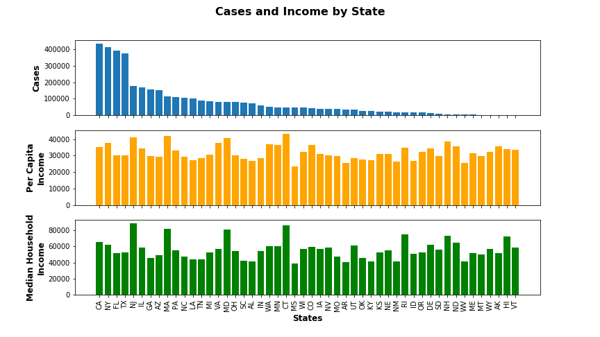
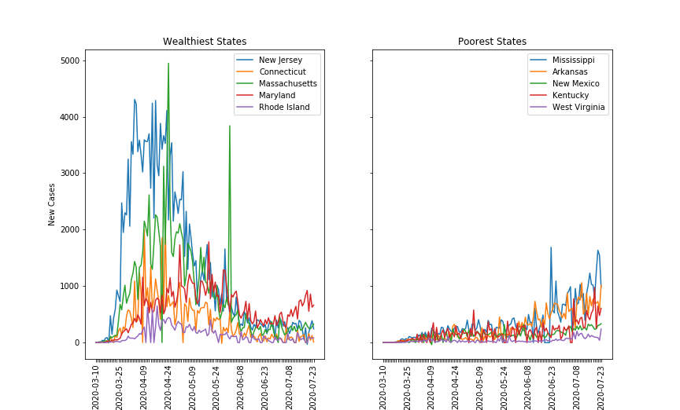
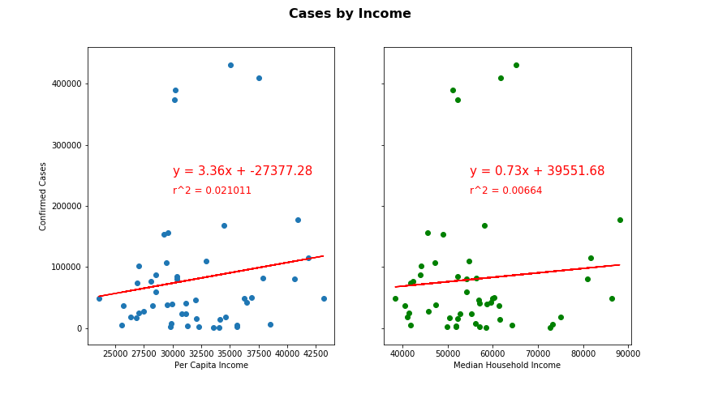
Does Income Impact Cases?

Slide 4
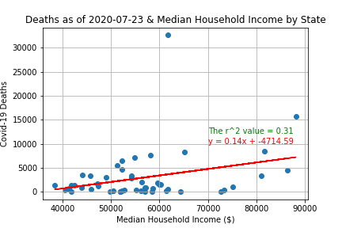
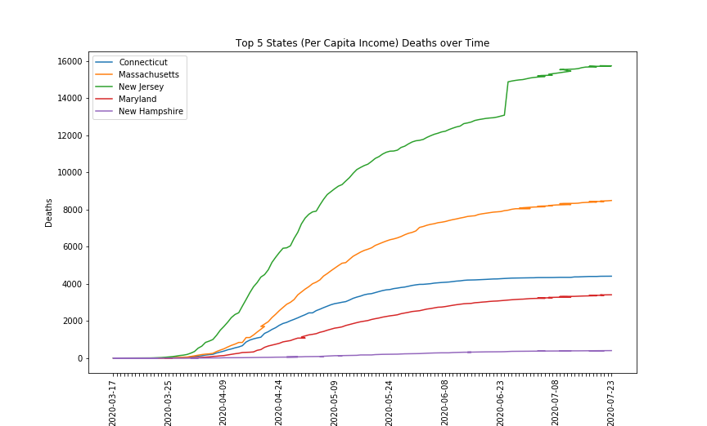
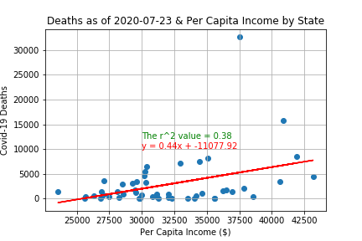

Slide 5
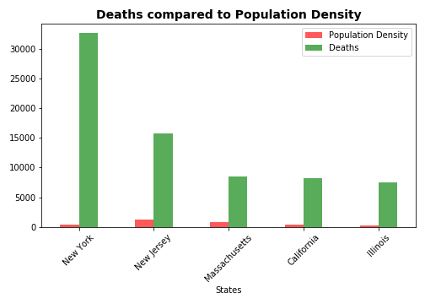
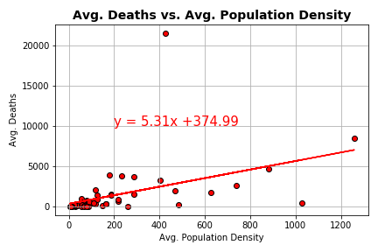
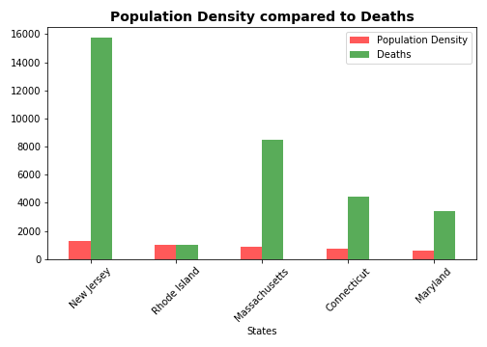
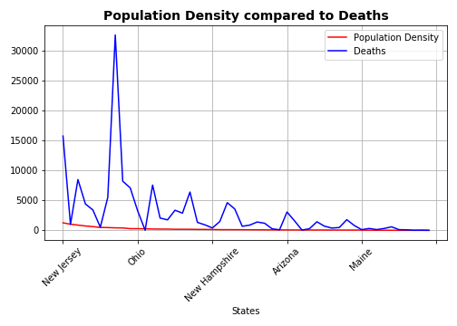

Slide 6
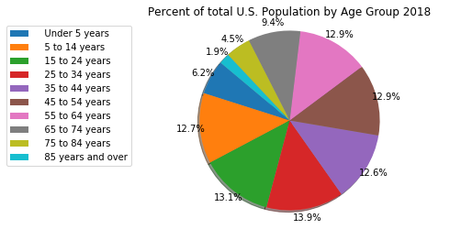
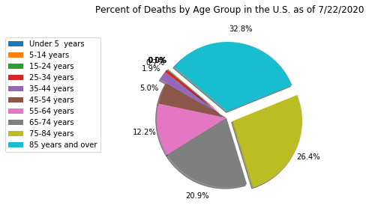
Percentage of Deaths by Age group vs. the General Population
This shows that over 59% of all deaths in the United Sates from Covid-19 were people aged 75 or older compared to the general population that represents only 6.4% of the total. Therefore, age plays a big factor in rates of death.

Slide 7
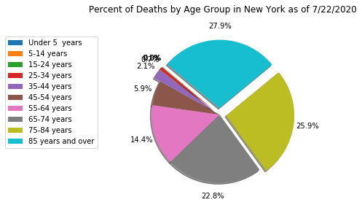
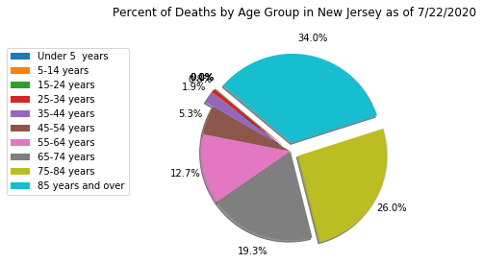
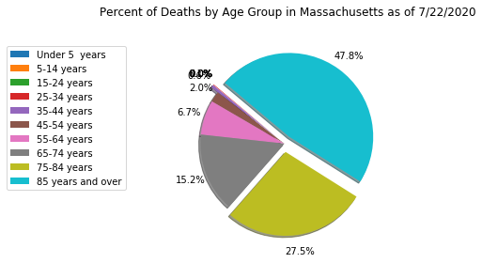
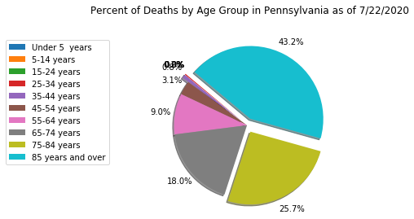
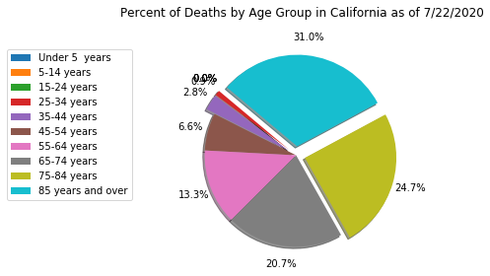
Percentage of Deaths by Age Group: Five Highest States
We see that the trend is consistent. Death rates increase with age.

Slide 8
Data Sources
www.census.gov (U.S. Census Bureau)
https://data.cdc.gov/NCHS/ (Center for Disease Control and Prevention)
https://pypi.org/project/uszipcode/ (Used to convert Zip Codes from Census to County and State)
https://pypi.org/project/us/ (Used to clean up junk state data from cases on cruise ships)
https://covid-api.com & https://rapidapi.com/search/covid
(Based on public data by Johns Hopkins CSSE)

